Slide 1
PRESENTATION ON online shopping
PRESENTED BY
Mohammad Ashraful Islam ; ID: 15162103013 ; SEC: 01 ; INTAKE: 32ND
Md. Mezanur Rahman Maruf; ID: 15162103022 ; SEC: 01 ; INTAKE: 32ND
Shamia Alom ; ID: 15162103010 ; SEC: 01 ; INTAKE: 32ND
Sarwar Alam Darji ; ID: 15162103028 ; SEC: 01 ; INTAKE: 32ND
Supervised by: Md. Raisul Alam (Assistant Professor)
DEPARTMENT OF B.Sc. in CSE

Slide 2
Discussion topic
Why we have chosen this system
Hardware & software requirements
Features
Design
Limitations & Future Enhancement

Slide 3
Why we have chosen this system
Promoting a service or product online.
Selling a service or product.
Providing product support or customer service.

Slide 4
Hardware & software requirements
Hardware Requirements:
Processor : Intel® Core™ i5 7th Generation or more
RAM : 8 GB or More
Hard disk : 256 GB or More

Slide 5
Software Requirements:
Front End : HTML,CSS,PHP
Back End : JAVA
Operation System : Windows 7 or Windows 8 or Windows 10

Slide 6
Features
Free or competitive shipping options
Advanced navigation and search functions
Superior photos and image options
A detailed product description
Customer reviews of the product
A fast guest check-out option

Slide 7
Design

Slide 8
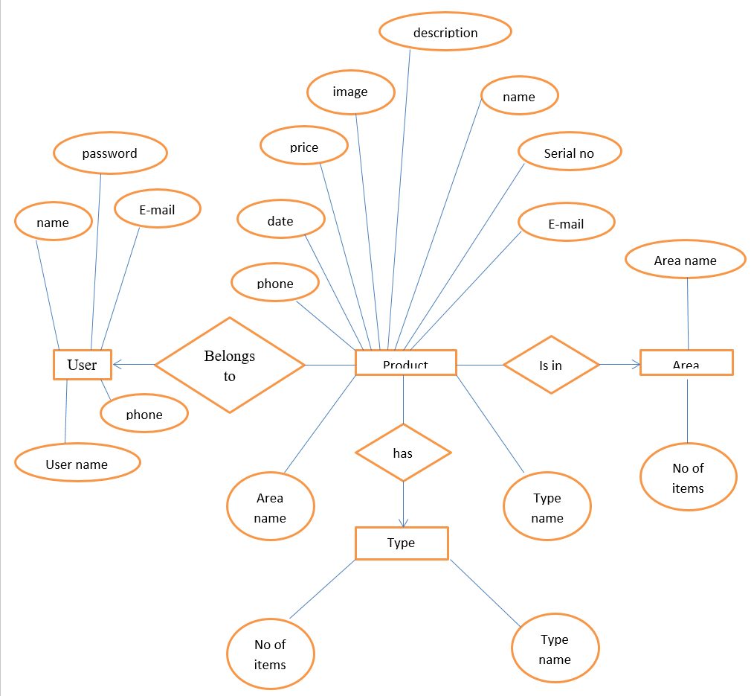
ER-Diagram for Online Shopping

Slide 9
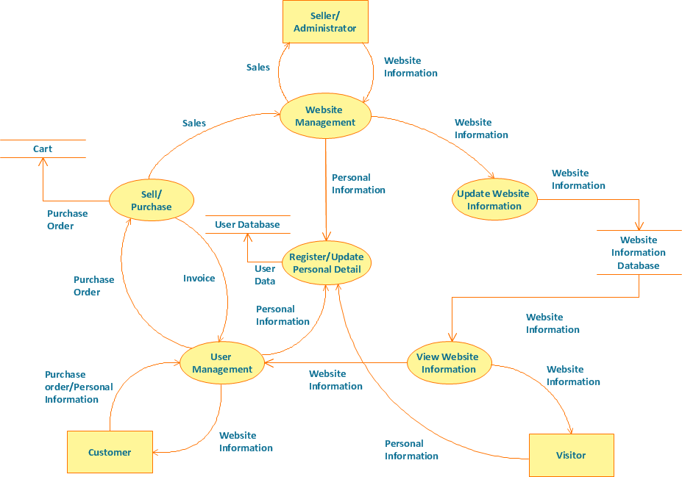
Data flow Diagram for Online Shopping

Slide 10
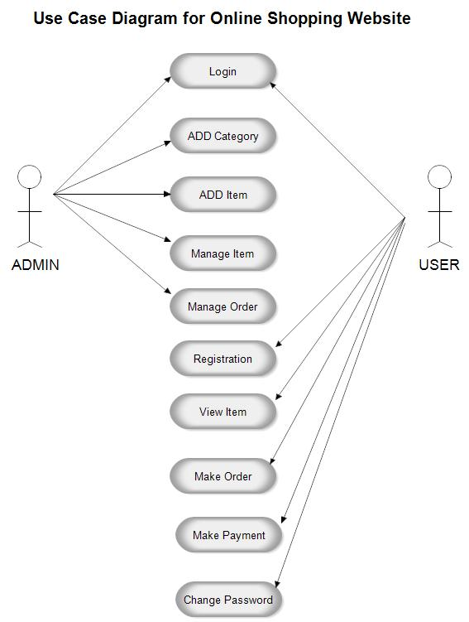

Slide 11
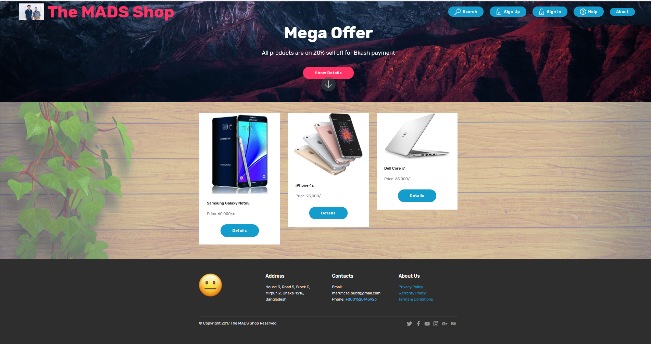

Slide 12
Limitations & Future Enhancement
Limitations:
The system is not configured for multi-users at this time.
The website is not accessible to everyone.
Less security

Slide 13
Future Enhancement:
Advertisement of new products.
Notifications of user cart, sales, discount offer etc.
Online payment gateway.
Live chat.

Slide 14
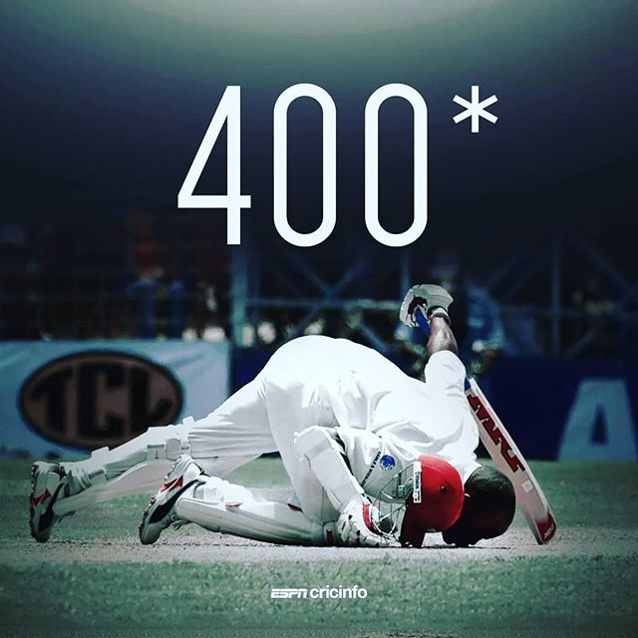
If you want to be memories, then you have to create history
Not Out
Brian Lara
The Cricket Monarch Of
the World 😐
Thank you
For
Watching 😐

